Slide 1

PROJECT REVIEW ON
CYBER ATTACK DETECTION MODEL (CADM) BASED ON MACHINE LEARNING
VAAGDEVI INSTITUTE OF TECHNOLOGY AND SCIENCE
(Affiliated to JNTU Ananthapuramu)
Roll numbers
Project Associates
1. D. Lakshmi Narasimhulu
2. C. Guru Teja
3. D. Shanath Reshon
4. R. Pradeep
5. S. Noor Basha
20L21A0510
20L21A0508
20L21A0511
20L21A0540
20L21A0543
PRC committee:
Project Guide:
S. Hassain, MTech Asst. Prof, CSE Dept
T. Krishna Reddy, MTech Asst. Prof, CSE Dept
D. Sasikala, MTech Asst. Prof, CSE Dept
HOD:
Mr. V. Narasimha Swamy, MTech
HOD of CSE Department
T. Krishna Reddy
MTech Asst. Prof, CSE Dept

Slide 2

CADM (Cyber Attack Detection Model Based on Machine learning)
A Cyber attack detection model based on machine learning is a system that uses algorithms to analyze network and system data, identifying patterns and anomalies to detect potential cyber threats or malicious activities.

Slide 3

ABSTRACT
A reliable Cyber Attack Detection Model (CADM) is a system that works as safeguard for the users of modern technological devices and assistant for the operators of networks. The research paper aims to develop a CADM for analyzing the network data patterns to classify cyber-attacks. CADM finds out attack wise detection accuracy using ensemble classification method. Gradient Boosting and Random Forest algorithms have been used for classification.

Slide 4
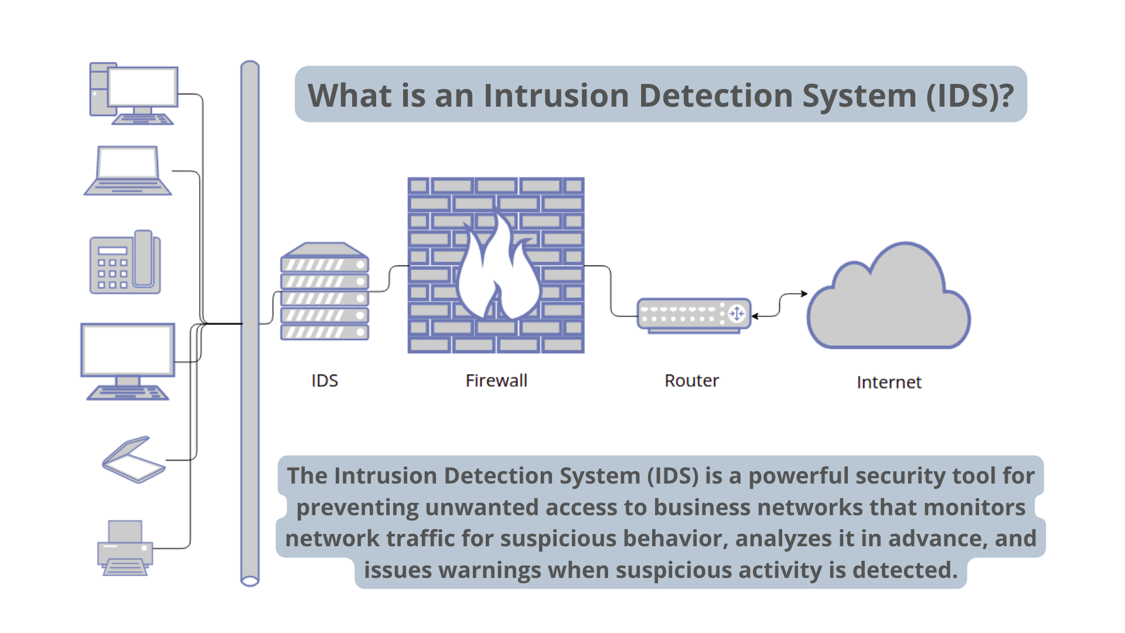
EXISTING SYSTEM
Researchers have used different techniques like Blameless Bayes, Principal Component Analysis (PCA), and Support Vector Machines (SVM) with datasets like KDD99 for Intrusion Detection Systems (IDS). However, KDD99 is old and lacks information on modern attack types. So, we choose to use the more recent CICIDS2017 dataset for our study. It contains up-to-date information and includes new attack types, unlike KDD99.

Slide 5

DRAWBACKS
These systems may exhibit limitations in timely threat detection, struggle with encrypted data, generate false alarms, and require significant human intervention, highlighting challenges in addressing the dynamic nature, inability to prevent denial-of-service (DoS) attacks, a biometric security measure, and many more.

Slide 6
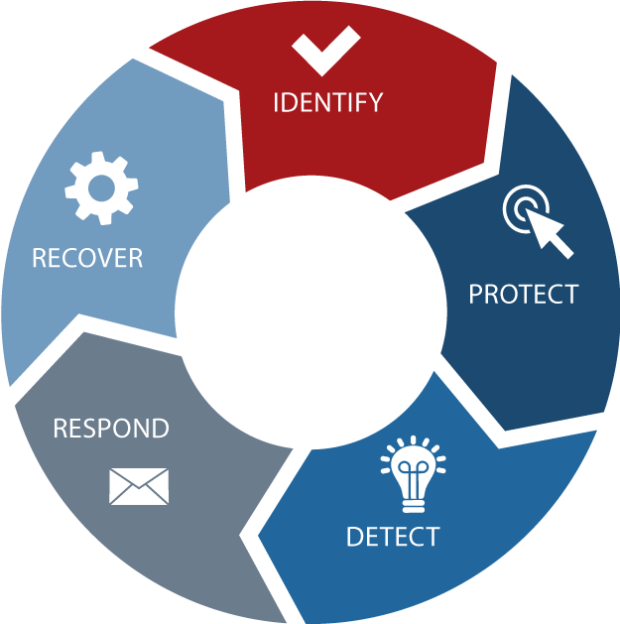
PROPOSED SYSTEM
The proposed system has four main steps. First, we normalize the dataset to make sure all features are on the same scale. Then, we split the dataset into testing and training sets. After that, we use four different algorithms—Random Forest (RF), Artificial Neural Network (ANN), Convolutional Neural Network (CNN), and Support Vector Machine (SVM)—to create our IDS models. Finally, we evaluate the performance of each model using metrics like accuracy, precision, recall, and F1-score to see how well they detect intrusions.

Slide 7

ADVANTAGES
Enhances Security
Identifies Threats Promptly
Prevents Potential Damage
Ensures Data and Network Safety
Utilizes Ensemble Classification for Accuracy
Adaptable to Various Cyber Threats

Slide 8
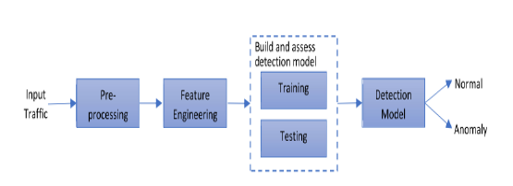
SYSTEM ARCHITECTURE :
1.Gather Data: Collect enough data and valid software samples.
2. Prepare Data: Improve performance using Data Augmentation techniques.
3. Train and Test: Split data into train and test sets. Train the model with the former, and evaluate performance with the latter.
4. Detect Attacks: Use the trained model to determine if a given transaction is normal or anomalous.

Slide 9
SOFTWARE & HARDWARE REQUIREMENTS
OS : Windows, Linux
Processor : minimum intel i3
Ram : minimum 4 GB
Hard disk : minimum 250 GB
Python IDE 3.7 version (or)
Anaconda 3.7 (or)
Jupiter (or)
Google Colab

Slide 10
WORKING MODULES
1. Data Collection:
Collect sufficient data samples and legitimate software samples.
2. Data Preprocessing:
Data Augmented techniques will be used for better performance
3. Train and Test Modeling:
Split the data into train and test data, Train will be used for training the model and Test data to check the performance.
4. Attack Detection Model:
Based on the model trained algorithm will detect whether the given transaction is anomalous or not.

Slide 11
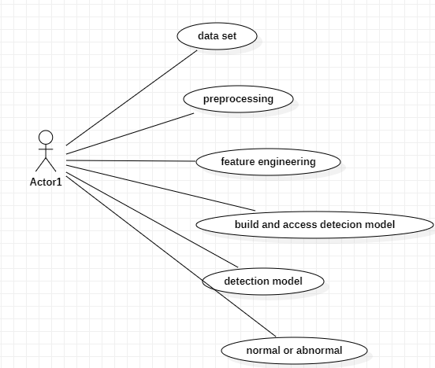
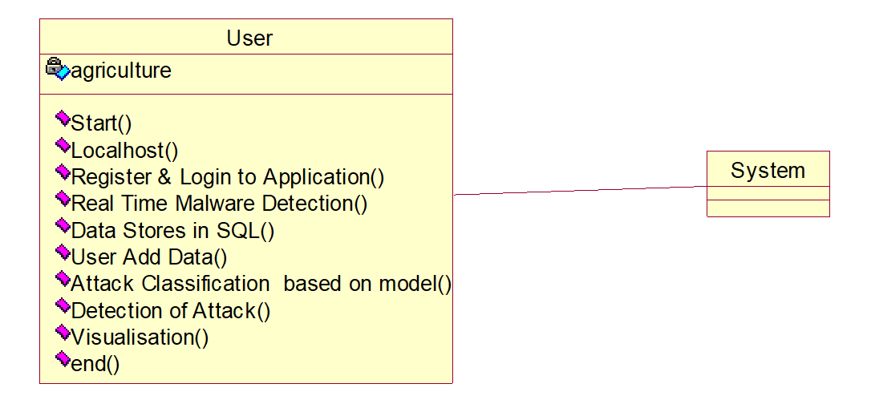
UML (Unified Modeling Language)
(a) Use case
(b) Class diagram

Slide 12
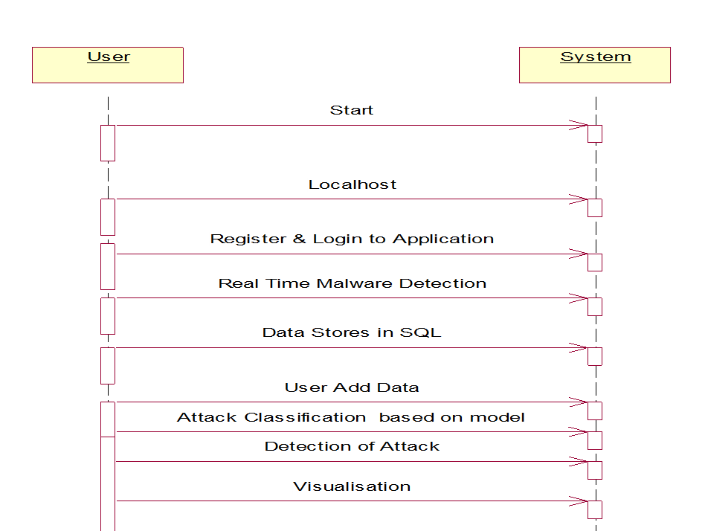
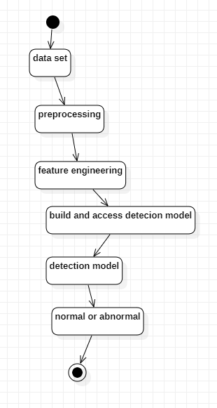
(c) Sequence
(d) Activity

Slide 13
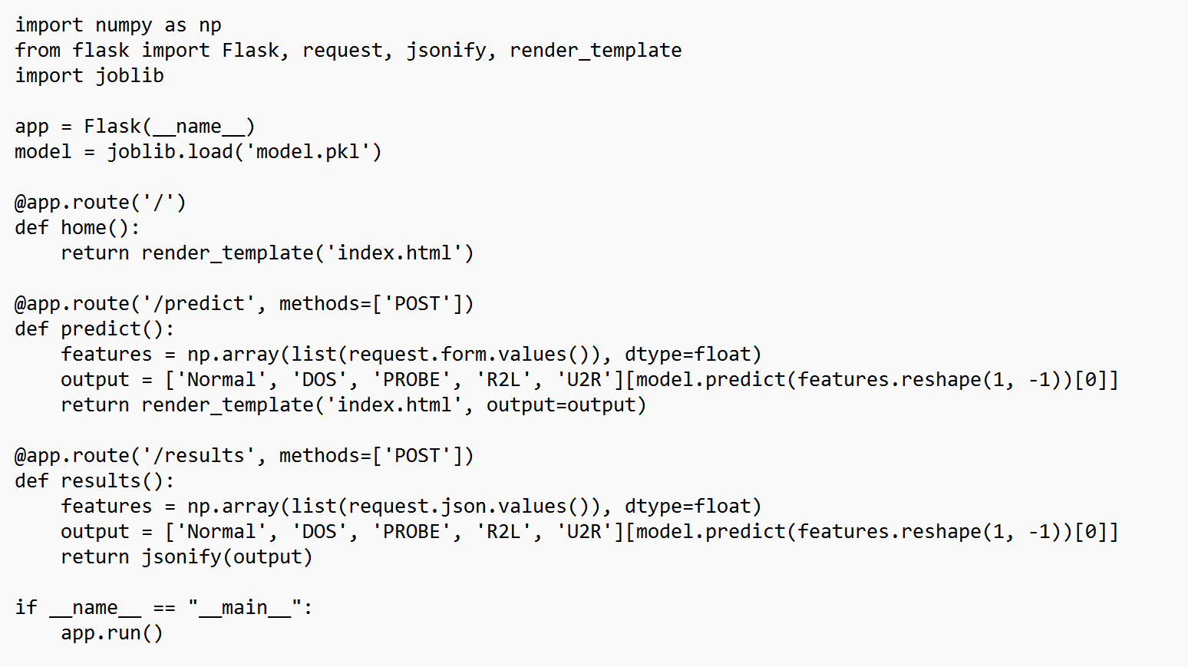
SAMPLE CODE :

Slide 14
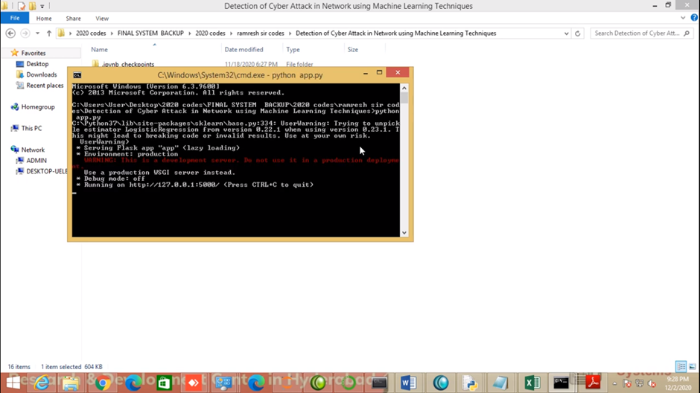
OUTPUT SCREENS :

Slide 15
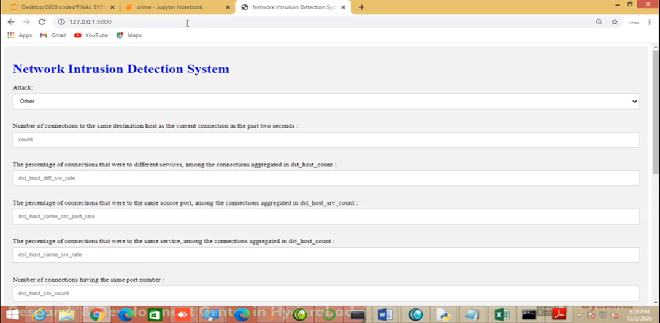

Slide 16
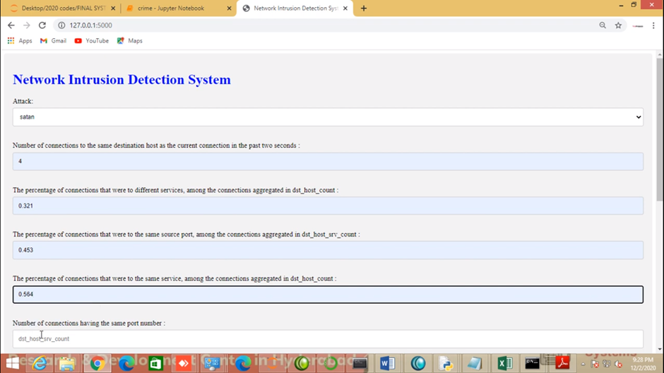

Slide 17
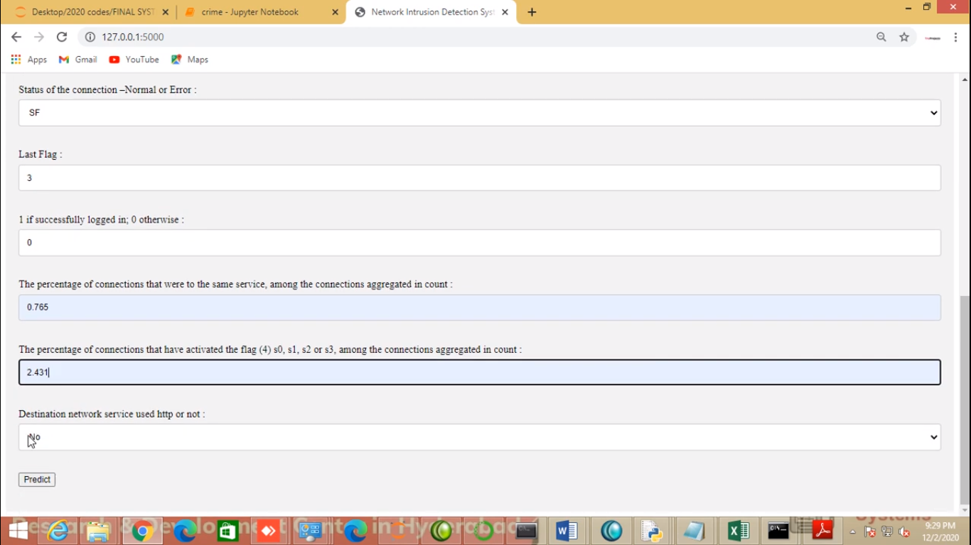

Slide 18
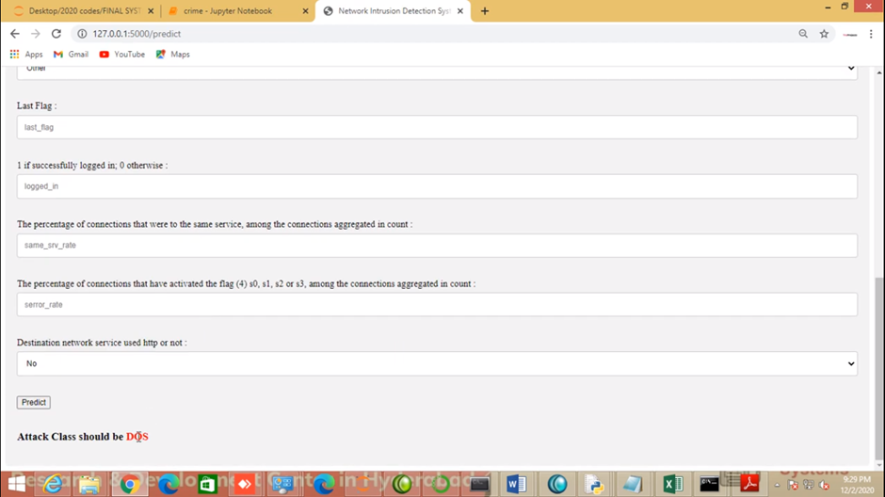

Slide 19
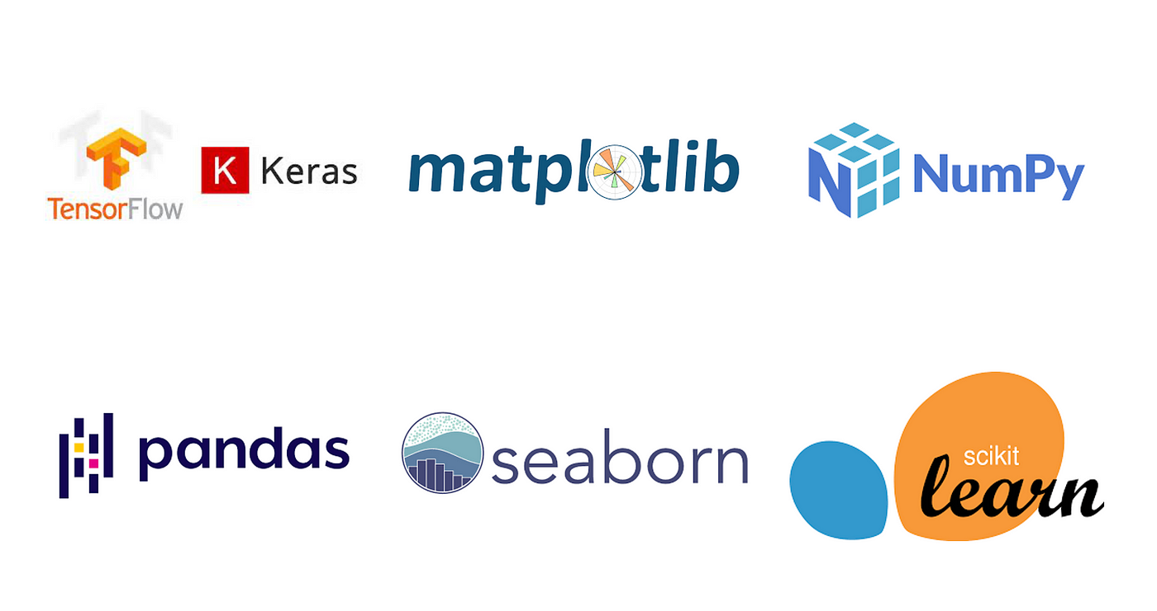
TECHNOLOGY AND PYTHON PACKAGES
Machine Learning
Python
NumPy, pandas, Keras, scikit-learn, tkinter, matplotlib, Pillow, imutils.
TensorFlow, OpenCV, NLP, NLTK, etc

Slide 20
CONCLUSION :
At the present time, assessments of help vector machine, ANN, CNN, Random Forest and significant learning estimations reliant upon current CICIDS2017 dataset were presented moderately. Results show that the significant learning estimation performed generally best results over SVM, ANN, RF and CNN.. Every one of these estimation assists us with recognizing the digital assault in network. It occurs in the manner that when we think about long back a long time there might be such countless assaults occurred so when these assaults are perceived then the highlights at which esteems these assaults are going on will be put away in some datasets.

Slide 21
TEST CASES:
UNIT TESTING
INTEGRATION TESTING
FUNCTIONAL TESTING
SYSTEM TESTING
WHITE BOX TESTING

Slide 22
FUTURE SCOPE:
Advanced Threat Detection: Evolving models to detect new and sophisticated cyber threats by analyzing patterns and anomalies. Real-time Detection and Response: Developing models capable of quickly identifying and responding to threats as they occur, minimizing damage. Adaptive and Self-learning Systems: Creating models that continuously learn from new data, improving detection accuracy over time. Integration with Security Ecosystems: Seamless integration with existing security tools like SIEM systems for comprehensive threat detection. IoT Security: Extending detection capabilities to analyses data from Internet of Things (IoT) devices and prevent attacks in real-time.

Slide 23

ANY QUERIES ?

Slide 24

THANK YOU!

